Slide 1


Socio-Economic Issues of Pakistan

Slide 2
CHILD ABUSE AND CHILD LABOUR IN PAKISTAN
An In-depth Exploration of Child Protection Issues in Pakistan

Slide 3
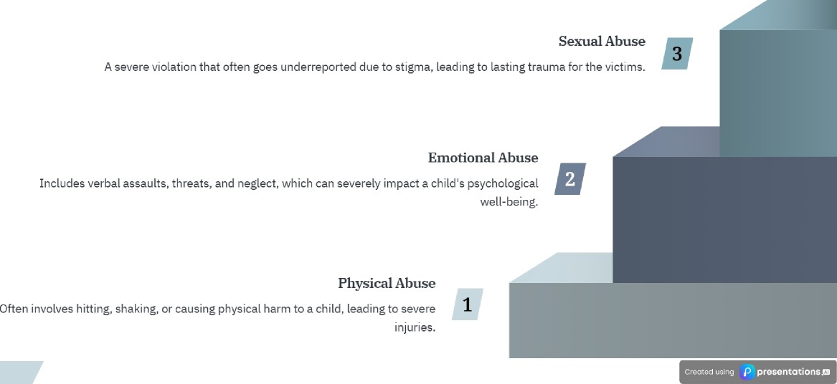
Exploring the different forms of child abuse prevalent in society

Slide 4


Understanding Key Factors and Approaches to Combat Child Labor
1
Poverty | Lack of education | Familial pressure
Economic hardship forces families to rely on child | Limited access to education perpetuates the cycle | Familial obligations often compel children to
labor for survival. | of child labor. | contribute financially.
Economic reforms
Implementing economic policies can alleviate poverty and reduce reliance on child labor.
Educational reforms
Enhancing educational access and quality is vital to combat child labor.
Societal reforms
Societal changes are necessary to shift perceptions and reduce child labor practices.
^œn'ea 1°nç preseutotions

Slide 5


FAIB
Addressing Child Abuse and Child Labour in Pakistan
Child Protection Act
Employment of Children Act
Weak enforcement of
laws
Lack of awareness
Need for strengthening legal frameworks
Focuses an safeguarding children against abuse, ensuring their rights and welfare.
Limited public knowledge about Child rights and protective laws contributes to ongoing abuse.
Prohibits child labor under specific conditions to protect children's rights.
f1any laws are not effectively enforced, leading to persistent issues in child protection.
There is a critical need to enhance existing laws to better protect children from abuse and exploitation.
^œn'ea 1°nç preseutotions

Slide 6
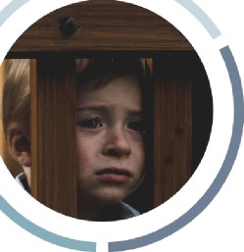

Understanding the underlying factors in Pakistan
Poverty
Poverty forces families to rely on child labor for survival, as financial hardshi p limits options.
1
Cultural Norms In some areas, cultural acceptance of child labor perpetuates th e cycle of aouse and neglect.
Education
Lack of access to education leads to children being more vulnerable to exploitation and abuse.
3
^œn'ea 1°nç preseutotions

Slide 7
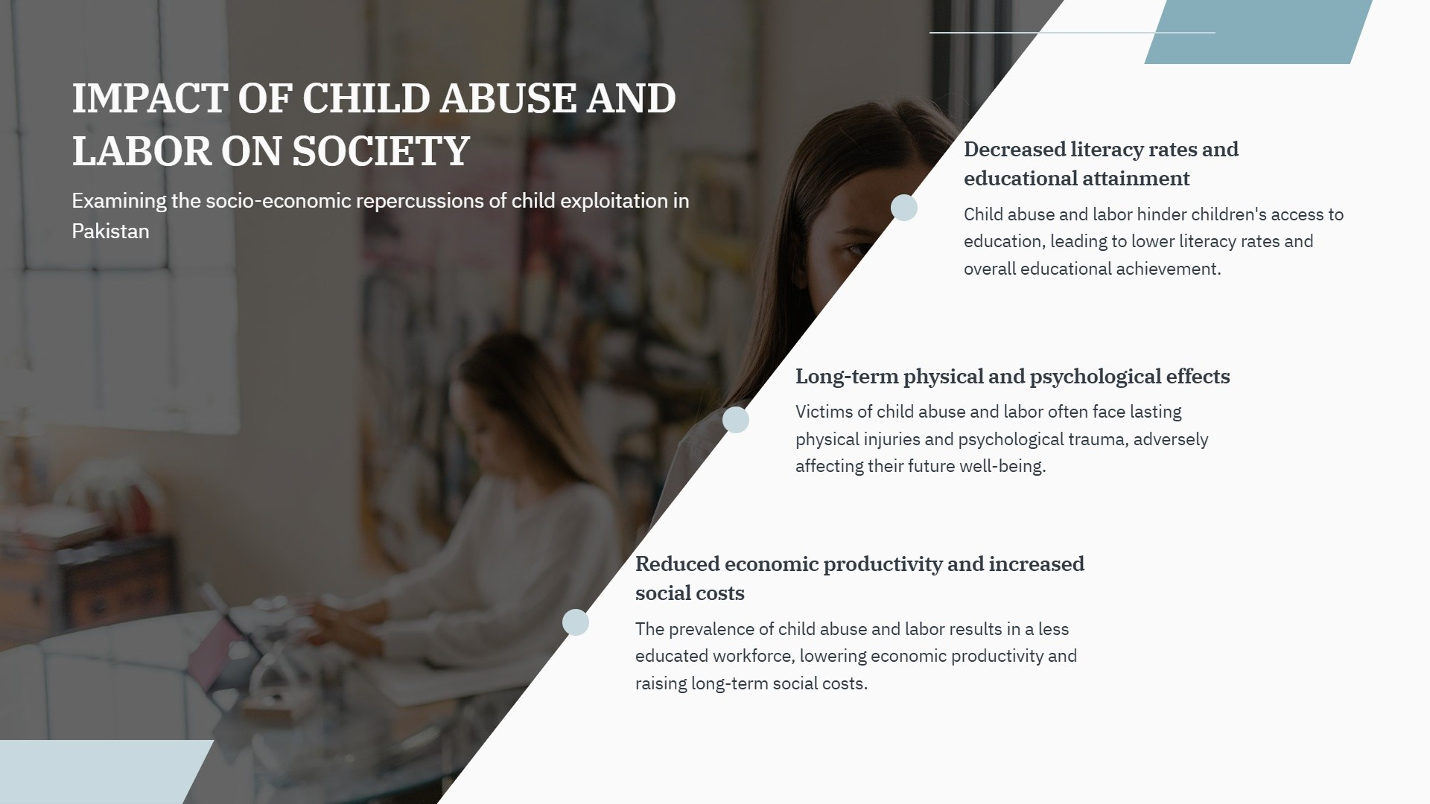


Slide 8



Highlighting the Urgent Need for Action Against Child Abuse and Labour
Girl in Punjab
A 12-year-old girl was forced into labor to support her family after her father's illness, highl›gnting the dire circumstances many
children face.
Boy in Karachi
A 10-year-old boy suffered physical abuse, resulting in severe trauma, demonstrating the impact of child abuse on young lives.
^œn'ea 1°nç preseutotions

Slide 9
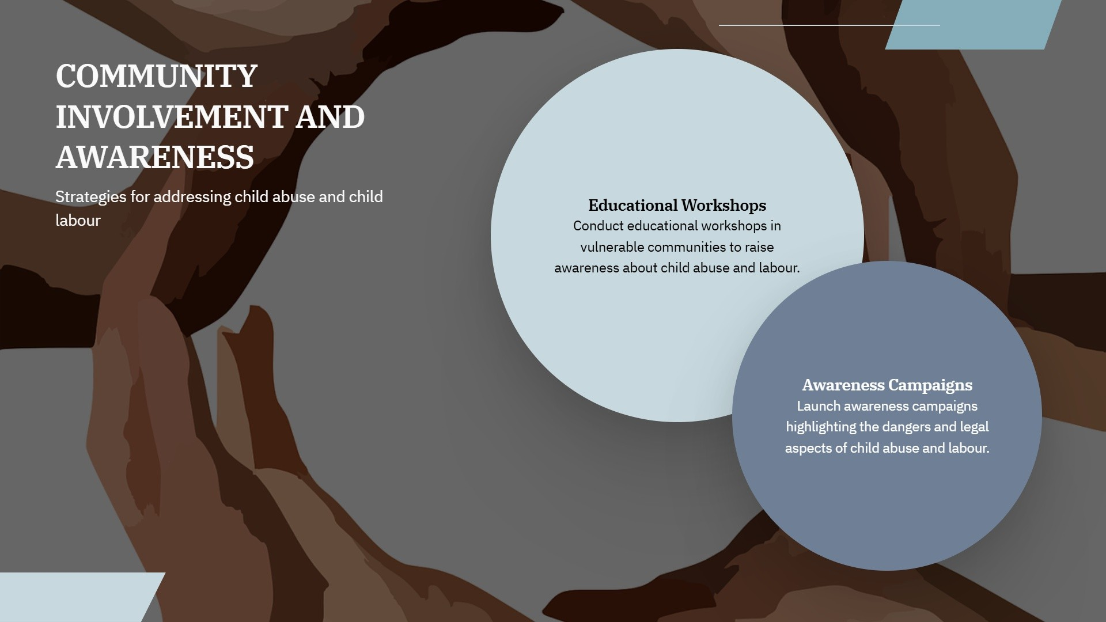

Slide 10


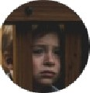


Exploring efforts and obstacles in child protection in Pakistan
Education Programs
Initiatives to increase school enrollment and reduce child labor.
Lack of Political Will
Inadequate commitment from political leaders to
prioritize child protection.
Legislative Reforms
Efforts to strengthen child protection laws for safeguarding minors.
Corrupdon
Corruption undermines government initiatives and child
welfare programs.
Insufficient funding and infrastructure hinder effective
implementation.
“ ^“
^œn'ea 1°nç preseutotions

Slide 11
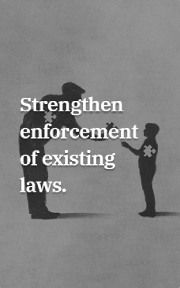
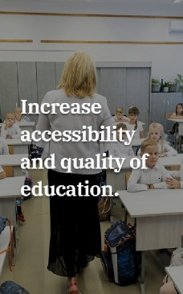
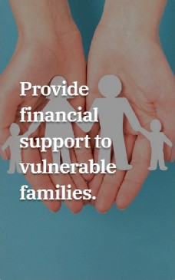

Strategies to Combat Child Abuse and Child Labour in Pakistan
Enhance the implementation of current regulations to protect children from abuse and exploitation.
Ensure that all children have access to high-quality education to reduce vulnerability to child labour.
Offer monetary assistance and resources to families at risk of resorting to child labour due to financial pressures.
’ œn el preseutotionsæ

Slide 12
TAKE ACTION AGAINST CHILD ABUSE AND LABOUR
3oin us in advocating for children's rights and welfare

Slide 13
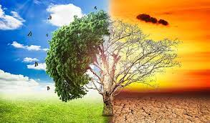
Climate change in pakistan

Slide 14
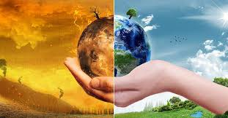
INTRODUCTION
CLIMATE CHANGE
Effects of Climate Change in Pakistan
Impact on Water Resources
EFFECT ON HEALTH AND SOCIETY
EFFECT ON AGRICULTURE
SOMG
EFFECT ON SMOG
Community and NGO Efforts
CONCLUSION

Slide 15
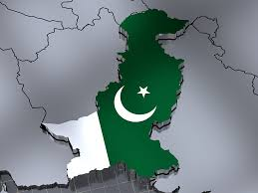
INTRODUCTION
Pakistan, officially the Islamic Republic of Pakistan, is a country in South Asia
It is the fifth-most populous country, with a population of over 241.5 million, having the second-largest Muslim population as of 2023.
Islamabad is the nation's capital, while Karachi is its largest city and financial centre.

Slide 16
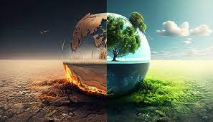
CLIMATE CHANGE
What is Climate Change?:Brief explanation of climate change, greenhouse gases, and global warming.
Global Impact: Briefly touch on the global effects of climate change (e.g., rising temperatures, melting glaciers, extreme weather events).
Why It Matters for Pakistan: Mention that Pakistan is one of the countries most vulnerable to climate change, despite low greenhouse gas emissions

Slide 17
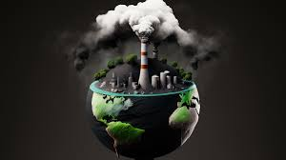
EFFECT OF GLOBEL WARMING
Fossil fuels – coal, oil and gas – are by far the largest contributor to global climate change, accounting for over 75 per cent of global greenhouse gas emissions and nearly 90 per cent of all carbon dioxide emissions.
As greenhouse gas emissions blanket the Earth, they trap the sun’s heat. This leads to global warming and climate change.
The world is now warming faster than at any point in recorded history. Warmer temperatures over time are changing weather patterns and disrupting the usual balance of nature.
This poses many risks to human beings and all other forms of life on Earth.

Slide 18
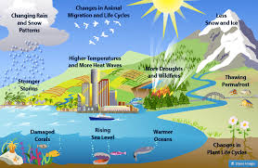

Slide 19
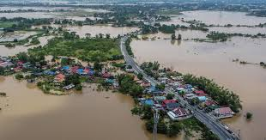
Impact on Water Resources
Decreased River Flow: How glacial melt affects river systems like the Indus, leading to long-term reduction in water availability.
Groundwater Depletion: Over-reliance on groundwater as surface water becomes scarce.
Conflict Over Water: Potential for regional and inter-provincial conflicts over water resources.

Slide 20
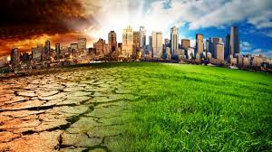
EFFECT ON HEALTH AND SOCIETY
Heat-Related Illnesses: Rise in diseases due to increased heat, especially in urban areas.
Vector-Borne Diseases: Spread of malaria and dengue as warmer temperatures and stagnant water provide breeding grounds for mosquitoes.
Displacement: Climate refugees forced to migrate due to flooding, droughts, or coastal erosion

Slide 21
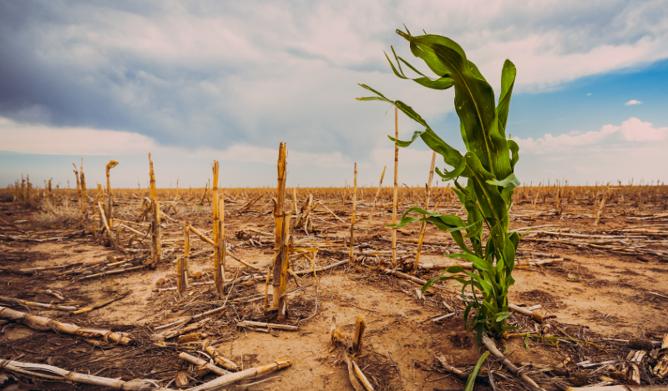
EFFECT ON AGRICULTURE
Changes in Crop Yield: How erratic weather and temperature changes reduce crop yields, especially wheat, rice, and cotton.
Water Scarcity: Increased droughts affecting water availability for irrigation.
Threat to Livelihoods: Effects on rural communities that depend heavily on agriculture, resulting in increased poverty and food insecurity.

Slide 22
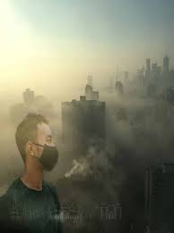
SMOG
The issue of smog in Pakistan, particularly during the winter months, has become increasingly severe and is a major public health and environmental concern. Here are some key points about the smog situation in Pakistan:
Causes of Smog
Industrial Emissions: Factories release pollutants into the air, contributing significantly to smog formation.
Vehicular Emissions: Increasing traffic and the use of older, less efficient vehicles lead to higher levels of nitrogen oxides (NOx) and particulate matter (PM).
Burning of Crop Residue: Farmers often burn crop stubble after harvest, which releases large amounts of smoke and particulate matter into the atmosphere.

Slide 23
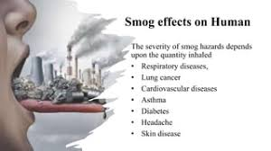

Slide 24
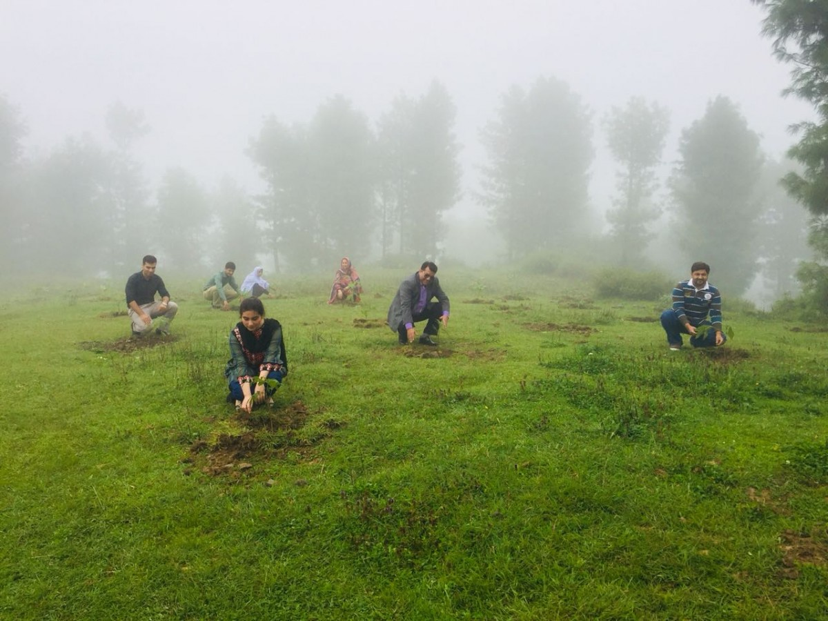
Community and NGO Efforts
Awareness Programs: Role of NGOs in educating communities about climate resilience
Local Adaptation Projects: Community-driven projects like rainwater harvesting, waste management, and sustainable agriculture.
International NGO Partnerships: How global organizations support Pakistan’s efforts in disaster preparedness and response

Slide 25
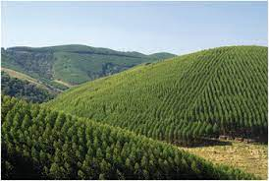
CONCLUSION
Summary: Briefly revisit the main points discussed, from Pakistan’s vulnerabilities to the economic and social impacts.
Call to Action: Emphasize the urgency for Pakistan to continue and expand climate adaptation and mitigation efforts.
Final Thoughts: Conclude with an optimistic note on the potential for resilience and sustainable development.

Slide 26
Domestic Violence In Pakistan

Slide 27
What is domestic violence?
Domestic violence, also known as intimate partner violence (IPV), is a pattern of abusive behavior in any relationship.
It is used to gain or maintain power and control over an intimate partner.
It includes physical abuse like hitting, emotional abuse such as manipulation or insults, sexual abuse, and economic control where one partner restricts the other's access to financial resources.

Slide 28
Forms of domestic violence
Physical
Emotional
Psychological
Financial
Sexual
Verbal

Slide 29
Victims of domestic violence
Domestic violence can affect anyone, regardless of gender, age, or social status, but predominantly targets women and children.
Although men can also be victims, women are disproportionately affected by domestic violence.
Primary victims
Statistical data shows that around 40% of women in Pakistan report experiencing physical or emotional violence in their lifetime.
On global average, where approximately 1 in 3 women experience some form of IPV.

Slide 30
Divorced, widowed, and separated women are often more vulnerable to domestic violence.
Domestic violence is frequently underreported due to societal stigma and fear of retaliation, leading to a significant gap between actual and reported cases.

Slide 31
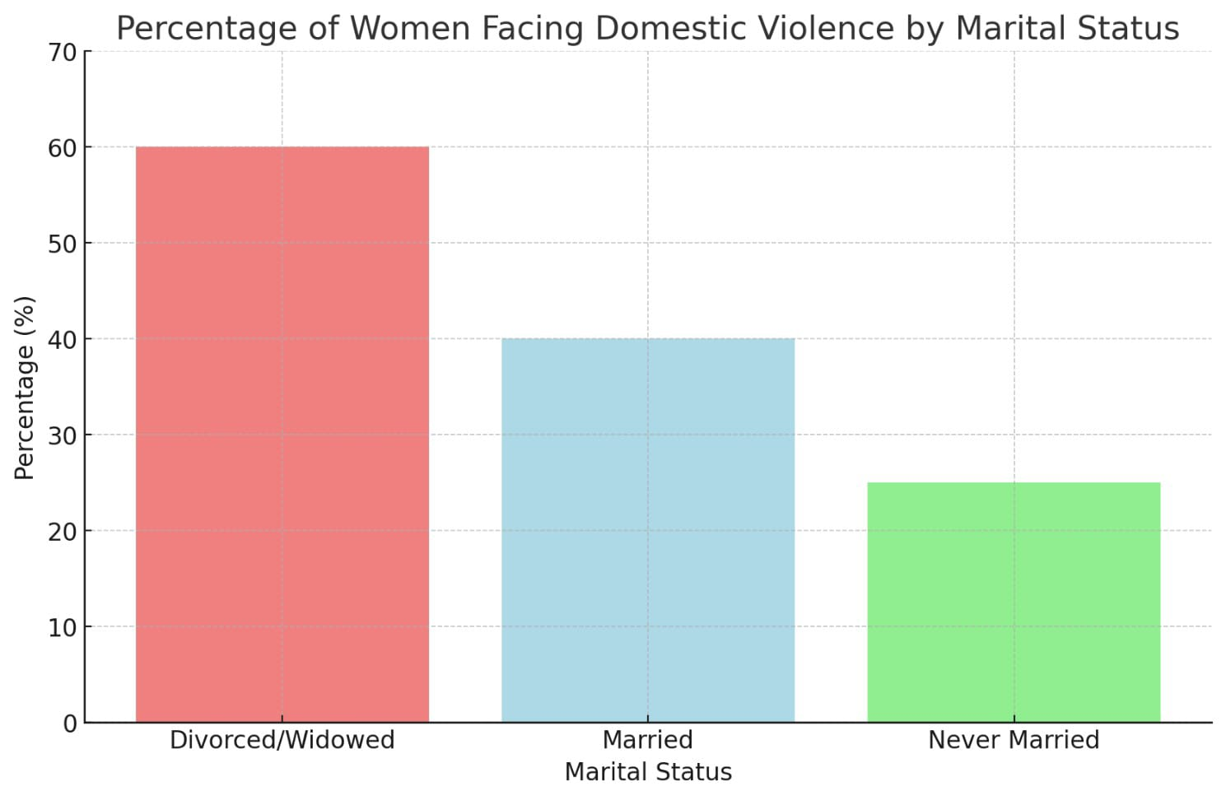

Slide 32
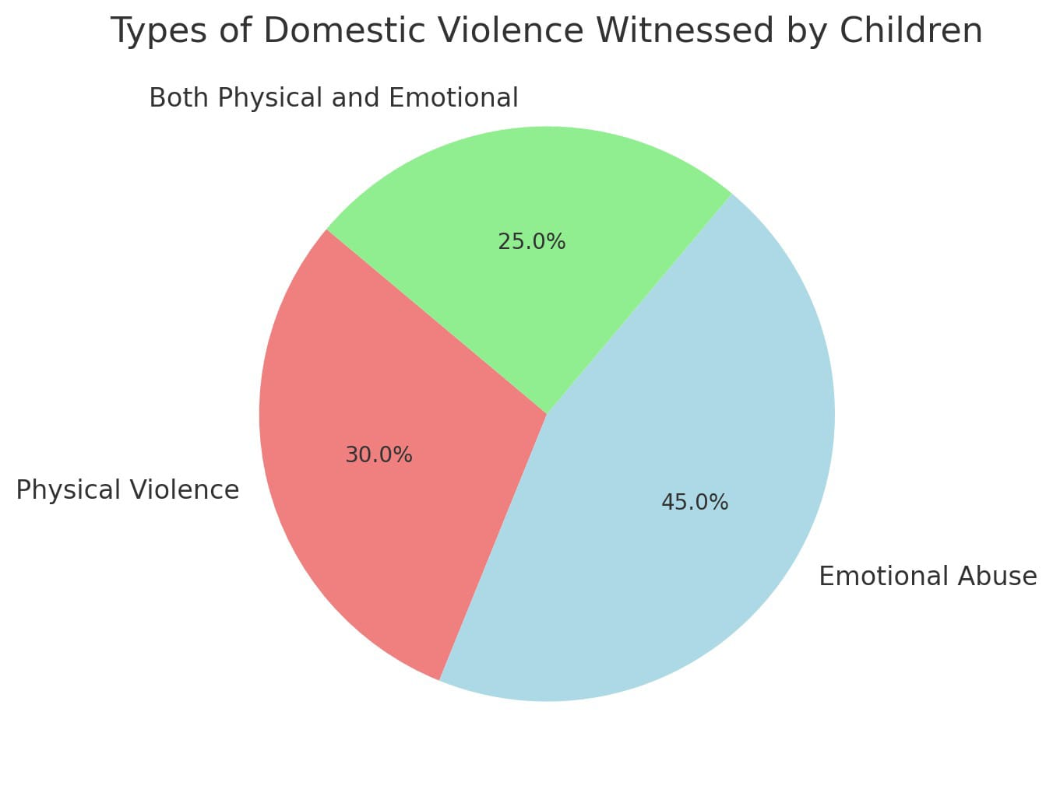
Children as secondary victims
Include that children witnessing domestic violence can suffer long-term psychological impacts.

Slide 33
Effects of Domestic Violence
Effects of Domestic violence on women:
Injuries
At workplace
Anxiety
Drug and alcohol dependence
Eating disorder
Malnutrition
Panic attacks
Self neglect
Suicide attempts
An inability to adequately respond to the needs of their children

Slide 34
Effects of Domestic Violence on Children:
They may become anxious or depressed
They may have difficulty sleeping
They have nightmares or flashbacks
They can be easily startled
They may complain of physical symptoms such as tummy aches
They may start to wet their bed
They may have problems with school
They may become aggressive
They may have a lowered sense of self-worth
Older children may begin to use alcohol or drugs
They may have an eating disorder

Slide 35
Conclusion
Domestic violence impacts individuals and families, often shattering lives behind closed doors. It’s not just a private issue but a societal one that requires collective awareness and action. By recognizing the signs, supporting victims, and challenging norms that perpetuate violence, we can create a safer, more compassionate world for everyone. Let’s commit to being the voice for the voiceless and part of the change that stops violence before it starts.

Slide 36
Drug Addiction
“Addiction isn't about using drugs, it's about what drugs does to your life”.
M.ZAID MANSOOR
FA23-BSM-043

Slide 37
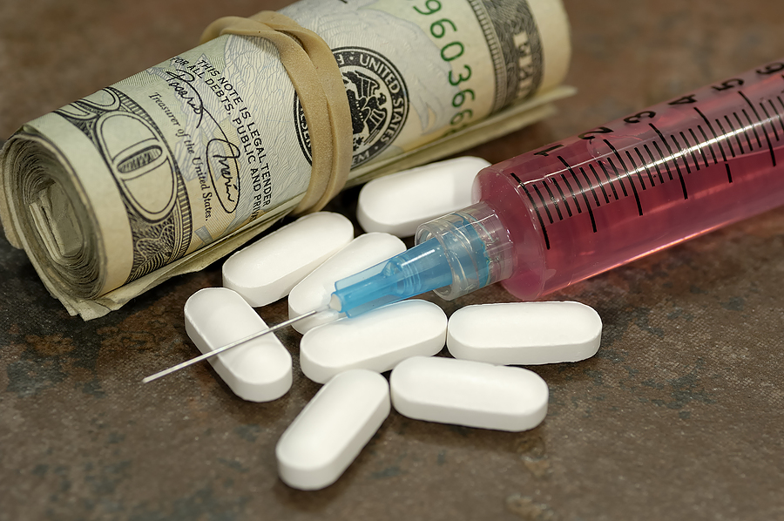
Introduction to Drugs
Drug addiction is A chronic disease affecting the brain, and just about everyone is different.
Drugs affect different people in different ways. One person can take and abuse drugs, yet never become addicted, while another merely has one experience and is immediately hooked

Slide 38
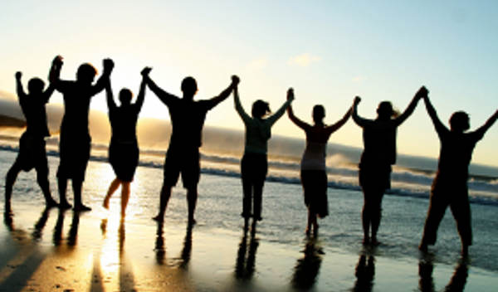
Introduction to Drugs
Introduction of Drug Addiction explains and is characterized by a person having to use the drug(s) repeatedly, regardless of the damage it does to;
- Their health
- Their family
- Their career
- Their relationships with friends and the community

Slide 39
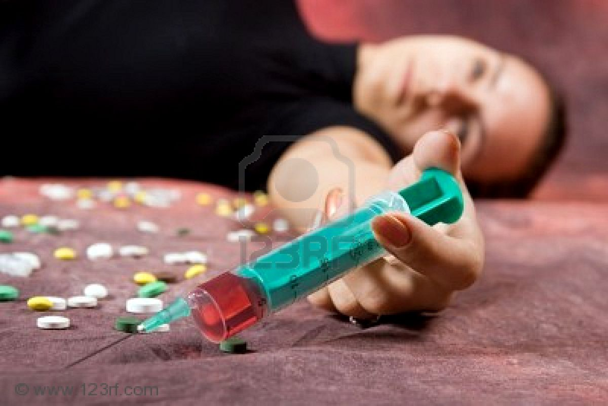
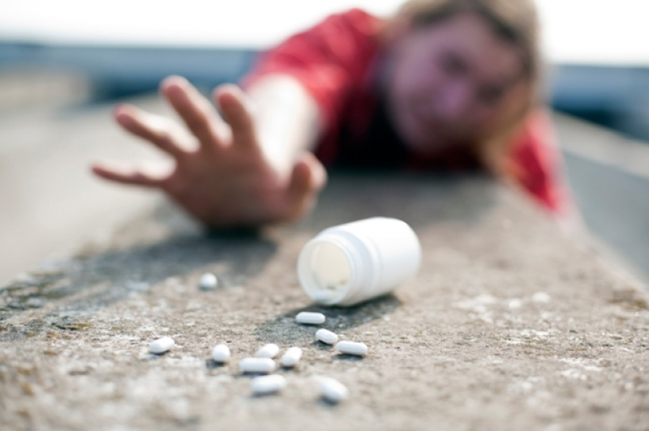
What is Addiction?
Addiction is not limited to drugs and alcohol. People can be addicted to many things, such as food, gambling, shopping, or most anything that gets in the way of a healthy lifestyle. When things get out of hand, and people behave compulsively, regardless of the consequences.
When the person is no longer in charge of their life, regardless of the triggering mechanism, they are addicted. The addiction can take over a person’s entire life. Nothing else matters.

Slide 40
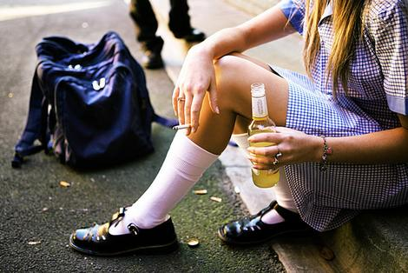
What Causes Drug Addiction?
There are several factors and causes to consider with addiction. First there is a genetic component, that is, what is passed on to you through your family.
If your blood relatives had a predisposition to become addicted, chances are you have that same tendency.
Personality contributes to drug addiction.
Peer pressure is huge, both for teenagers and adults alike.

Slide 41
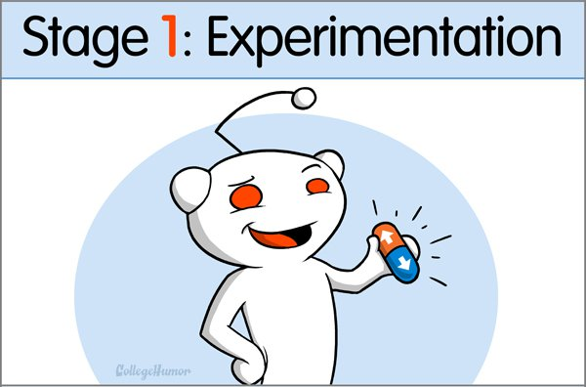
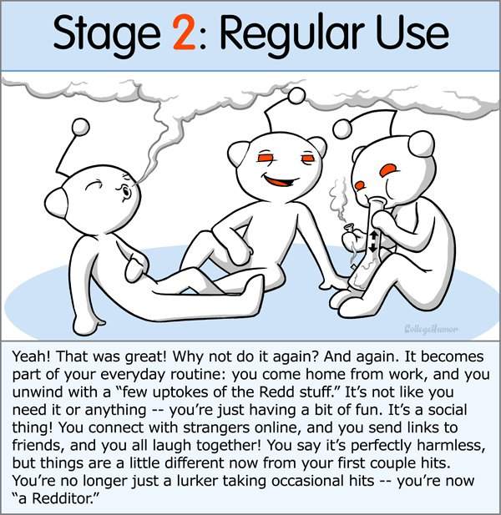
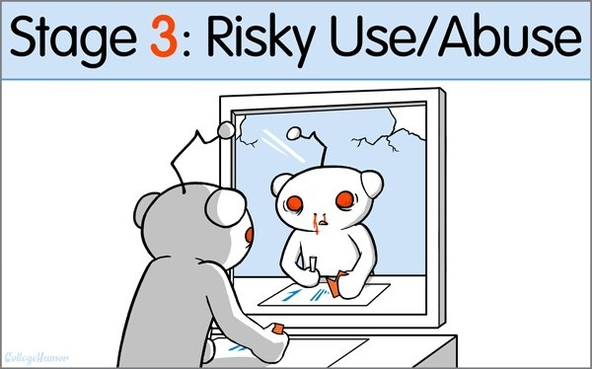
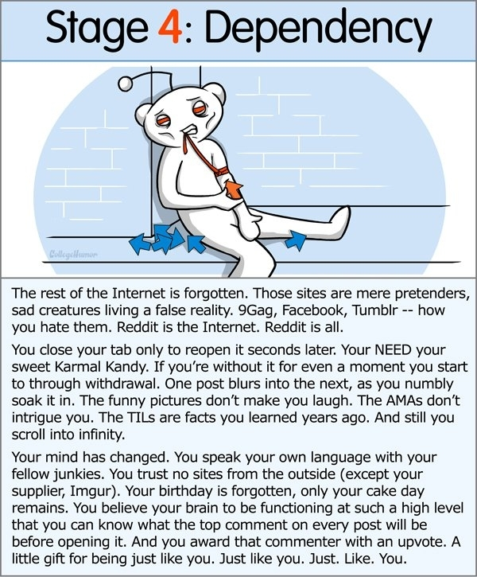
Stages of addiction

Slide 42
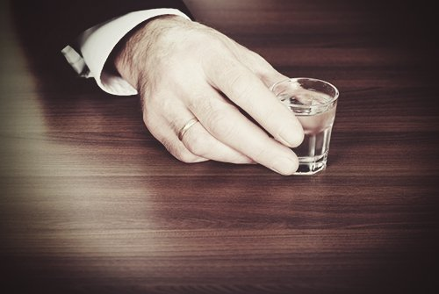
Stage 1
Curiosity is the motivator
Learning to trust/mistrust the drug used
“HIGH” is still a new feeling

Slide 43
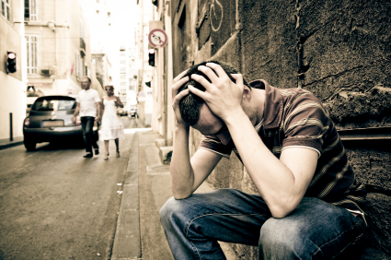
Stage 2
User is thinking more about drugs
Previous relationship becomes difficult
User uses when alone
User still thinks they have control

Slide 44
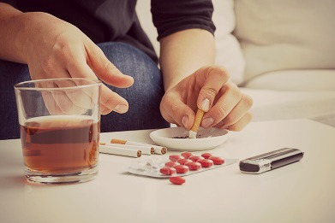
Stage 3
Seeks out the “HIGH”
Has confidence in using the drug
User think the drug won’t hurt them
Peer group uses

Slide 45
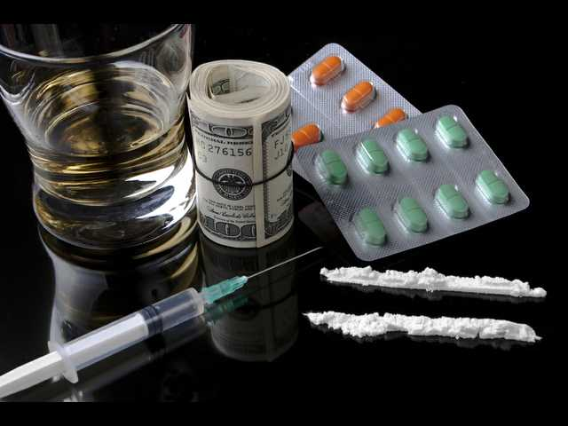
Stage 4
Can no longer get high
User uses the drug to avoid being sick
Drugs become the center of their life

Slide 46
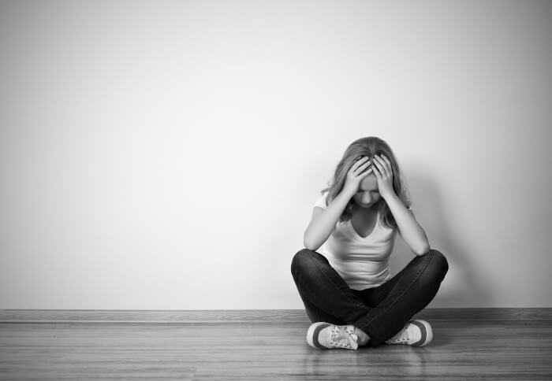
Side effects
Loss of appetite
Headaches
Anxiety
Elevated blood pressure
Chest pain
IRREGULAR HEARTBEAT
COLD/BLUISH FINGERS
CHANGES IN BODY TEMPERATURE

Slide 47
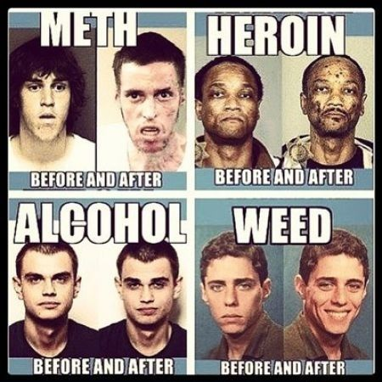
Consequences of drug addiction
Drugs are chemicals. Different drugs, because of their chemical structures, can affect the body in different ways. In fact, some drugs can even change a person's body and brain in ways that last long after the person has stopped taking drugs, maybe even permanently.

Slide 48
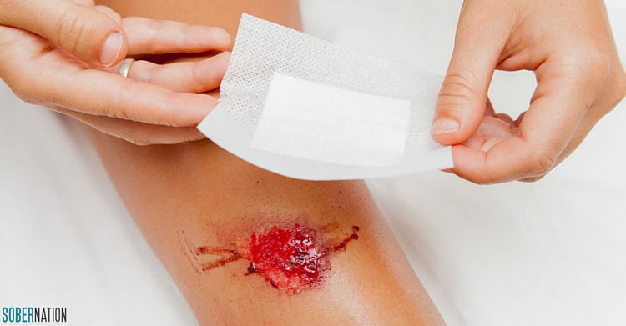
injuries
More deaths, illnesses and disabilities stem from substance abuse than from any other preventable health condition. Today, one in four deaths is attributable to illicit drug use. People who live with substance dependence have a higher risk of all bad outcomes including unintentional injuries, accidents, risk of domestic violence, medical problems, and death.

Slide 49
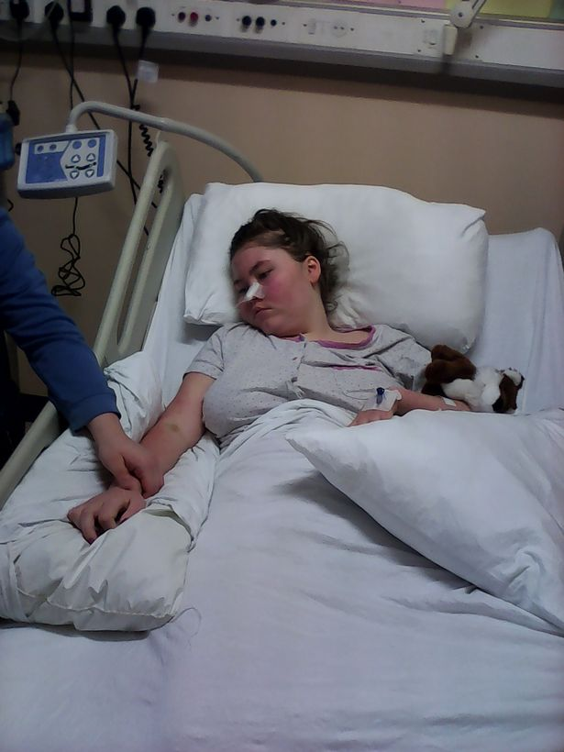
Health problems
Weaken the immune system, increasing susceptibility to infections.
Cause cardiovascular conditions ranging from abnormal heart rate to heart attacks.
Cause nausea, vomiting and abdominal pain.
Cause the liver to have to work harder, possibly causing significant damage or liver failure.
Cause seizures, stroke and widespread brain damage
Produce global body changes such as breast development in men, dramatic fluctuations in appetite and increases in body temperature, which may impact a variety of health conditions.

Slide 50
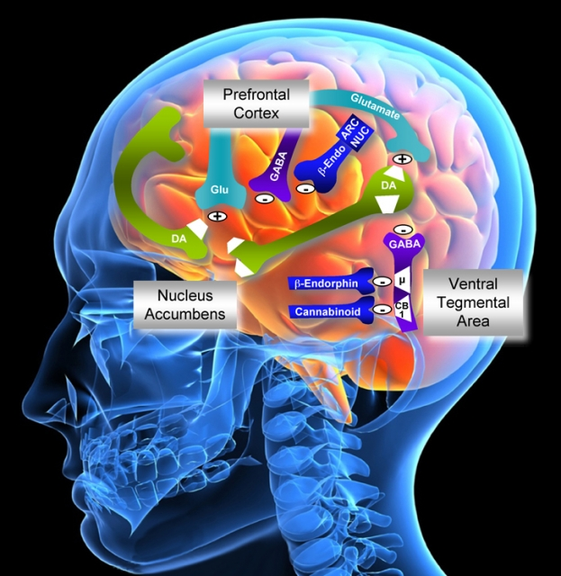
Effect on the brain
All drugs of abuse - nicotine, cocaine, marijuana, and others - effect the brain's "reward" circuit, which is part of the limbic system.
Drugs hijack this "reward" system, causing unusually large amounts of dopamine to flood the system.
This flood of dopamine is what causes the "high" or euphoria associated with drug abuse.

Slide 51
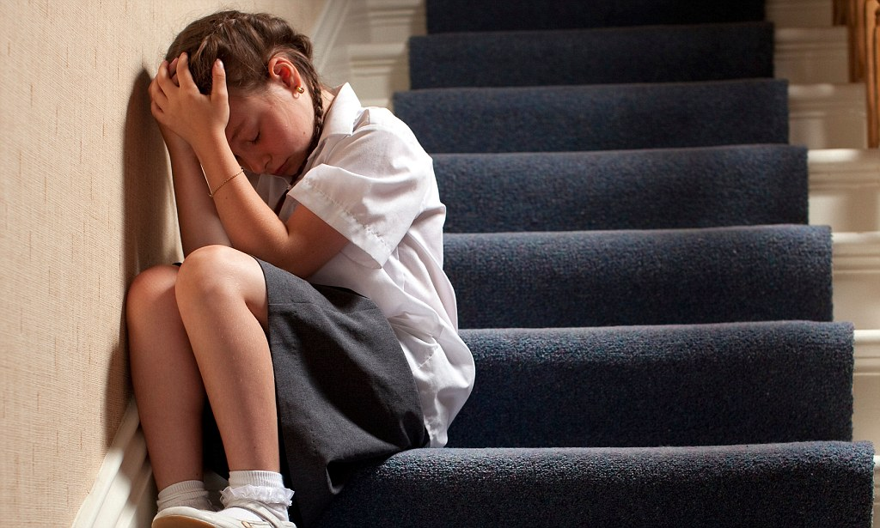
Behavioral problems
Paranoia
Aggressiveness
Hallucinations
Addiction
Impaired Judgment
Impulsiveness
Loss of Self-Control

Slide 52
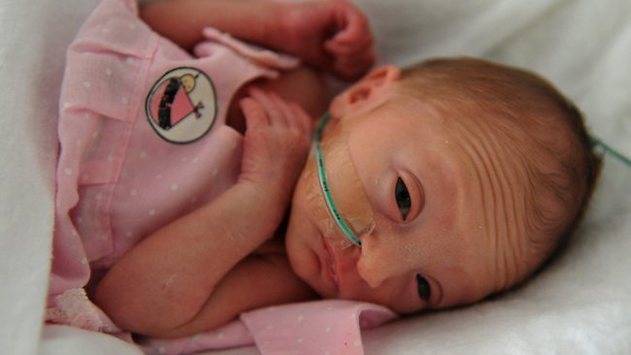
Birth defects
These and other illicit drugs may pose various risks for pregnant women and their babies. Some of these drugs can cause a baby to be born too small or too soon, or to have withdrawal symptoms, birth defects or learning and behavioral problems.
Pregnant women who use illicit drugs may engage in other unhealthy behaviors that place their pregnancy at risk, such as having extremely poor nutrition or developing sexually transmitted infections.

Slide 53
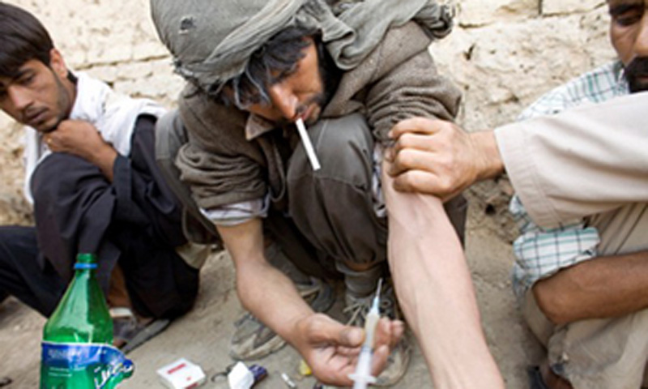
Pakistan dealing with drug addiction
Widespread drug abuse may be indicated by the fact that almost five percent of the adult population is using drugs in Pakistan. As a proportion of drug abusers, heroin users have increased from 7.5 percent in 1983 to a shocking 51 percent a decade later in 1993.

Slide 54
Growing numbers
The major consequence of this has been a significant increase in domestic consumption of heroin in Pakistan. Heroin was once upon a time a drug which was virtually unknown in the country until the late 1970s. Today, Pakistan is not only one of the main exporters of heroin, it has also become a net importer of drugs. It is estimated that about 50 tons of opium are smuggled into Pakistan for processing heroin for domestic use. Almost 80 percent of the opium processed in Pakistan comes from neighboring countries.

Slide 55
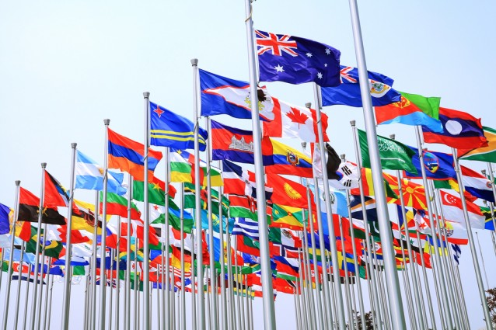
United nation fighting drug abuse
Pakistan is not alone in fighting this disease. With the globalization of the drug abuse problem in the last two decades, the situation has gone from bad to worse, so much so that the united nations commission on narcotic drugs no longer discusses individual situations. It has argued that the solution does not lie in the hands of individual countries. It has to be worked out through mutual efforts by south Asian countries.

Slide 56
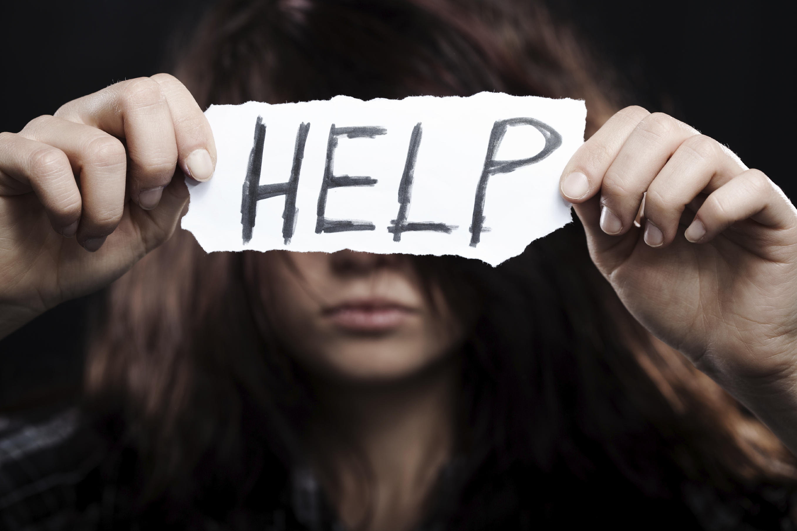
Overcoming drug addiction
Decide to make a change:
The way you deal with stress
Who you allow in your life
What you do in your free time
How you think about yourself

Slide 57
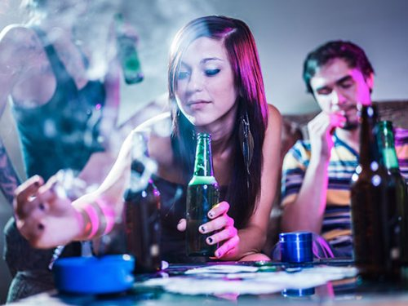
Overcoming drug addiction
Lean on close friends and family
Build a sober social network
Consider moving into a sober living home
Make meetings a priority
Make break with old drug buddies
Avoid bars and clubs
Use caution with prescription drugs

Slide 58
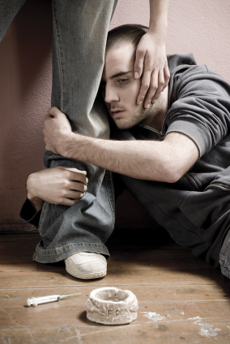
COPING WITH DRUG CRAVINGS
Get involved in some distracting activities
Talk it through
Urge surf
Challenge and change your thoughts

Slide 59
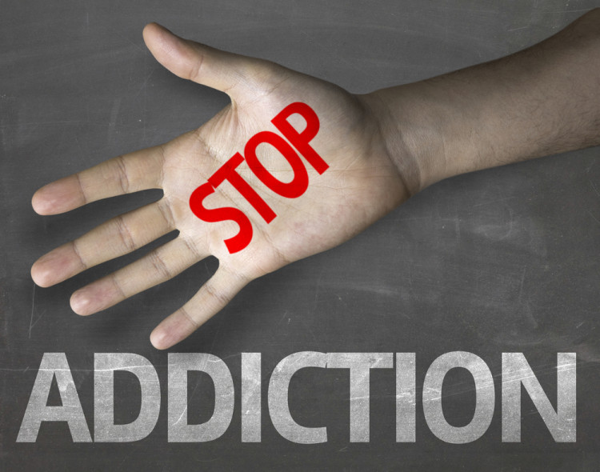
BUILD A MEANINGFUL DRUG FREE LIFE
Pick a new hobby
Adopt pet
Get involved in your community
Set meaningful goals
Look after your health

Slide 60
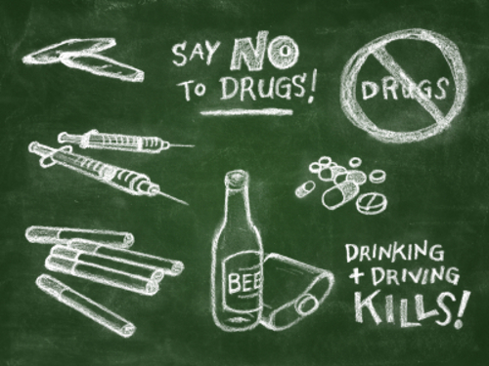

Slide 61


